Slide 1

Transportation service
system
for
grocery kart
BY ----
Deepank Kartikey

Slide 2
Motivation of topic
Transportation is a major problem domain in logistics, and so it represents a substantial task in the activities of many companies.
In some market sectors, transportation means a high percentage of the value added to goods.

Slide 3
Therefore, the utilization of computerized methods for transportation often results in significant savings ranging from 5% to 20% in the total costs.
We are interested in providing optimum solutions to the above problem using GENETIC ALGORITHM.

Slide 4
Why genetic algorithm ?
Genetic Algorithm is based on the Darwin’s theory of
“SURVIVAL OF THE FITTEST!!!”
Genetic algorithms tend to thrive in an environment in which there is a very large set of candidate solutions and where the search space is uneven and has many hills and valleys.

Slide 5
Genetic algorithm (GA) is a search heuristic that mimics the process of natural evolution.
Genetic algorithms belong to the larger class of evolutionary algorithm (EA), which generate solutions to optimization problems using techniques inspired by natural evolution, such as selection, crossover and mutation.

Slide 6
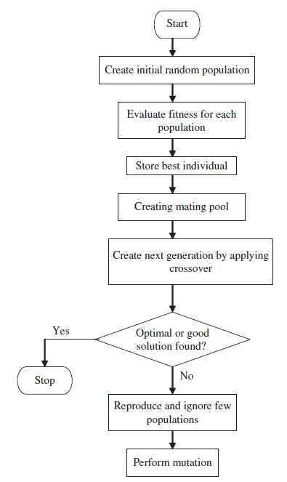
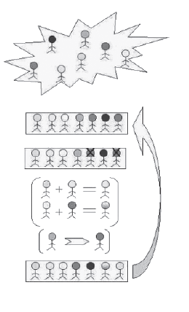

Slide 7
When to use Ga ?
Alternate solutions are too slow or overly complicated
Need an exploratory tool to examine new approaches
Problem is similar to one that has already been successfully solved by using a GA
Want to hybridize with an existing solution
Benefits of the GA technology meet key problem requirements

Slide 8
Ga IN tos..
From the varied scope of GA applications, one of the applications is “TOS” (Transportation Optimum Solutions).
The general scenario in the field of transportation presents many chances for several concrete definitions of subclasses of problems: determining the optimal number of vehicles, finding the shortest routes, etc.

Slide 9
All this subject to many restrictions like vehicle capacity, time windows for deliveries etc.
The basic problem we are discussing here consists in delivering goods to a set of customers with known demands through minimum-cost vehicle routes originating and terminating at the depot.

Slide 10
Problem statement
Grocery kart is responsible for supplying fresh vegetables to all the retail stores in city. A fleet of old matador vans are used to haul the goods from the central warehouse .
There are about 600 stores in their network.
Constraints on each van :

Slide 11
All the deliveries are to be made between 5AM to 8AM
Maximum number of stops are 20
Travelling distance not more than 65 km
Maximum load capacity is 1000 kg
At the end of the trip, each truck returns back to the central warehouse
Each stop at the store takes 5 min to download
Every km travelled takes 90 sec on an average

Slide 12
A new fleet of Mahindra vans are bought replacing the old matador vans in an effort to reduce costs and minimize green house emissions.
Maintaining each van costs Rs. 20000/month
The variable cost/km of travel is around Rs.30 for the first 3 years.

Slide 13
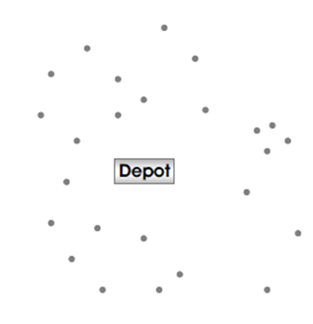
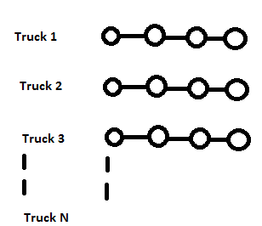
Store locations Central Warehouse
DEPOT
TOS
Using GA
OPTIMUM ROUTES

Slide 14
INPUT MODULE
OUTPUT MODULE
The distance between each store and the warehouse.
Daily demand for each store.
The number of trucks needed.
Routing of each truck.
Total miles travelled each day.
Total cost incurred.

Slide 15
Overall goals
Processing input data.
Compute the routing map on the basis of various factors given in the problem statement.
Profit, Cost and Efficiency analysis .

Slide 16
Generation of reports through comparative study of various cities and user data.
Comparative study of best solutions from evolved generations.

Slide 17
Functionalities
Population
There are two methods :-
generatePopulation()-diversity is generated by this method.
greedyGeneratePopulation(euclidRadius)-optimum solutions are generated by this method.

Slide 18
Selection
We have used Tournament Selection. There are two methods :-
tournamentSelection()
TournamentRankSelection() is used only when paretoRanking procedure is used.

Slide 19
Fitness Evaluation
We have used two methods here:-
Weighted sum approach-we have used this method initially,but as this method is quiet biased towards one criteria.
Pareto ranking- To get the alternative solutions of same nature we have used pareto ranking.

Slide 20
Crossover
The crossover is really the great deal to come up.
Two methods used -
1) The BCRC(Best Cost Route Crossover) used not only maintains the candidates’ good nature but improves it too to drive the force of obtaining a better solutions by manipulating existing good candidates.
Best explained in PPT image.

Slide 21
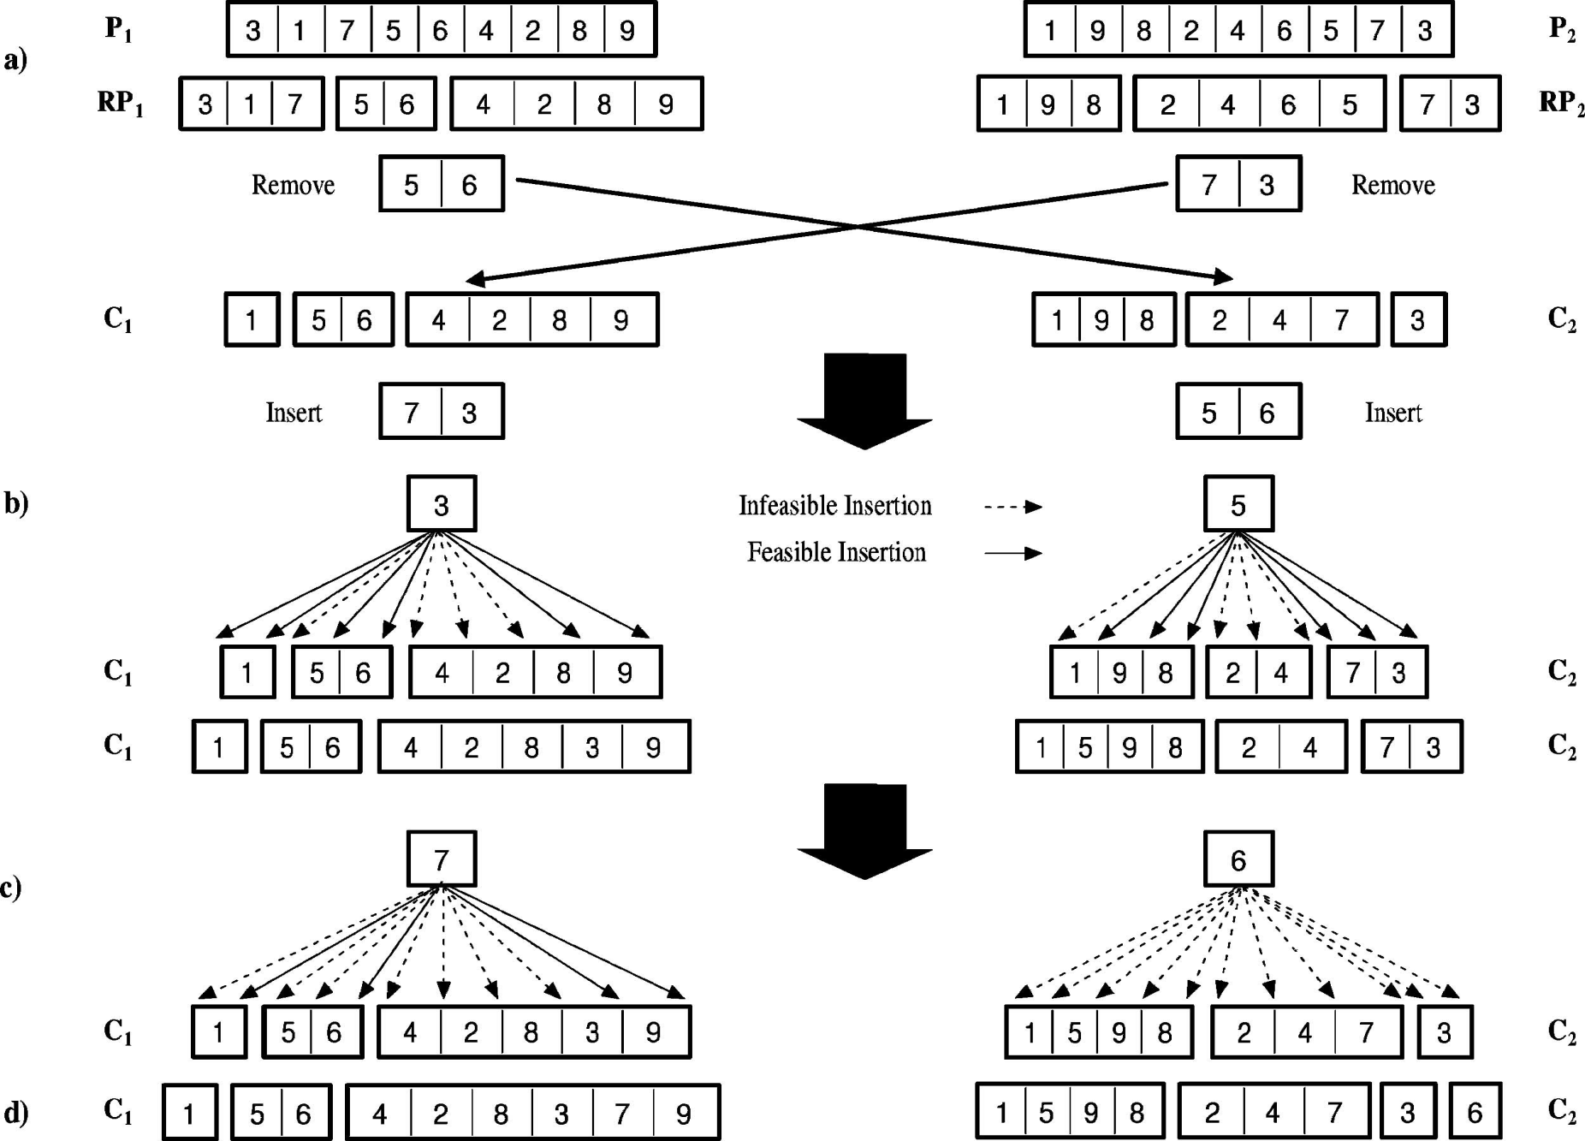
Crossover

Slide 22
2) Partially mapped crossover (PMX)
It aims at keeping as many positions from the parents as possible.
To achieve this goal, a sub string is swapped like in two point crossover & the values are kept in all other non conflicting positions.
The conflicting positions are replaced by the values which were swapped to the other offspring.

Slide 23
An Example :--
p1= (1 2 3 4 5 6 7 8 9)
p2= (4 5 2 1 8 7 6 9 3)
Assume the position 4-7 are selected for swapping.
Then the two offspring are given as follows if we omit the conflicting positions.
o1= (* 2 3|1 8 7 6|* 9)
o2= (* * 2|4 5 6 7|9 3)

Slide 24
Now we take the conflicting positions & in what was swapped to the other offspring.
For eg 1 and 4 were swapped. Therefore we have to replace the 1 in first position o1 by 4 & so on.
o1= (4 2 3 1 8 7 6 5 9)
o2= (1 8 2 4 5 6 7 9 3)

Slide 25
Mutation
We have used inversion operator to mutate a candidate. The length of inversion is fixed to 2 or 3 which get randomly selected and assigned to get flipped.

Slide 26
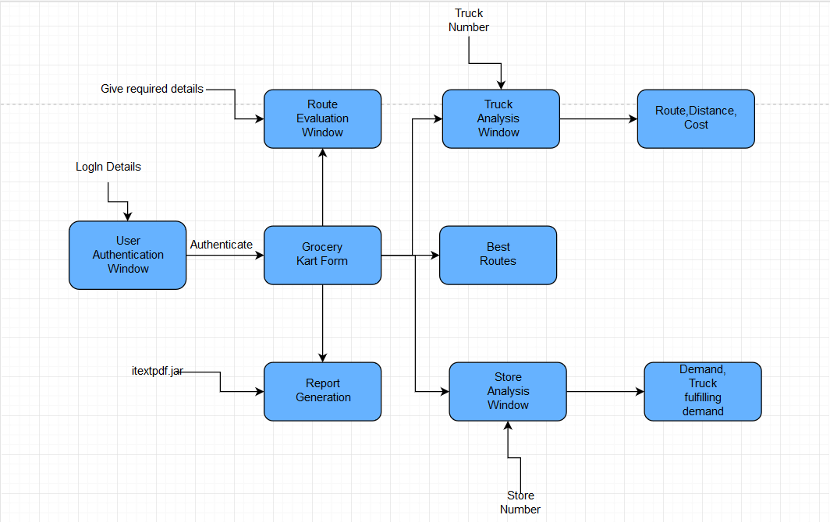
ARCHITECTURE

Slide 27
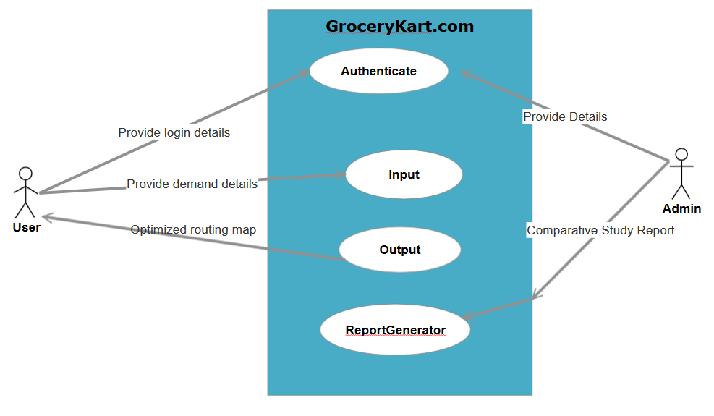
USE-CASE DIAGRAM

Slide 28
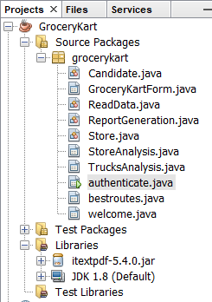
FILE STRUCTURE

Slide 29
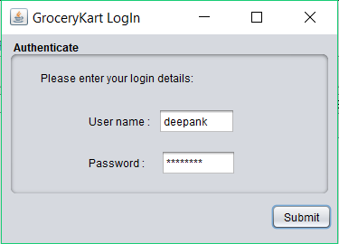
AUTHENTICATION

Slide 30
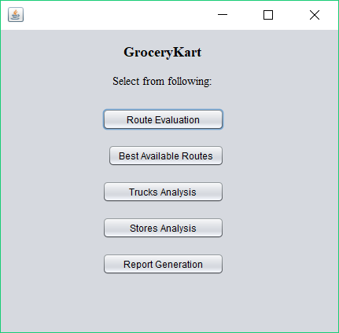
GROCERYKART OPTIONS

Slide 31
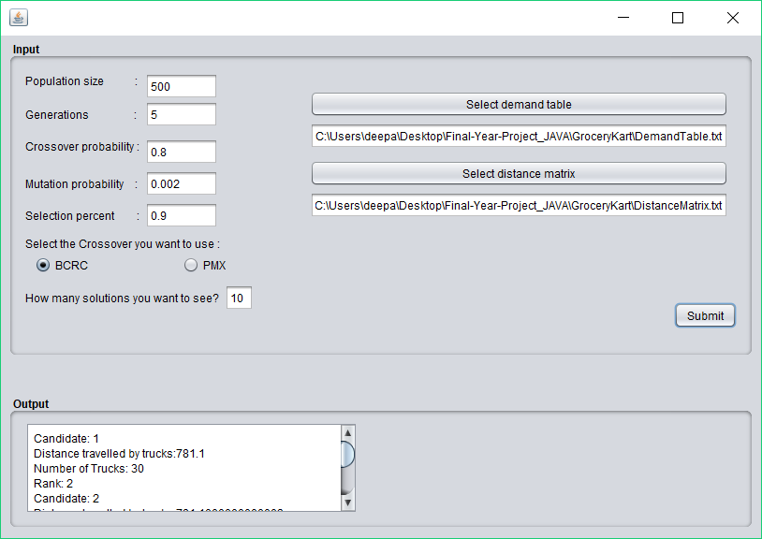
ROUTE EVALUATION

Slide 32
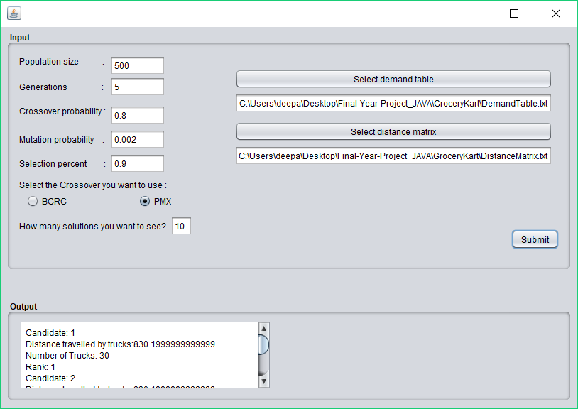

Slide 33
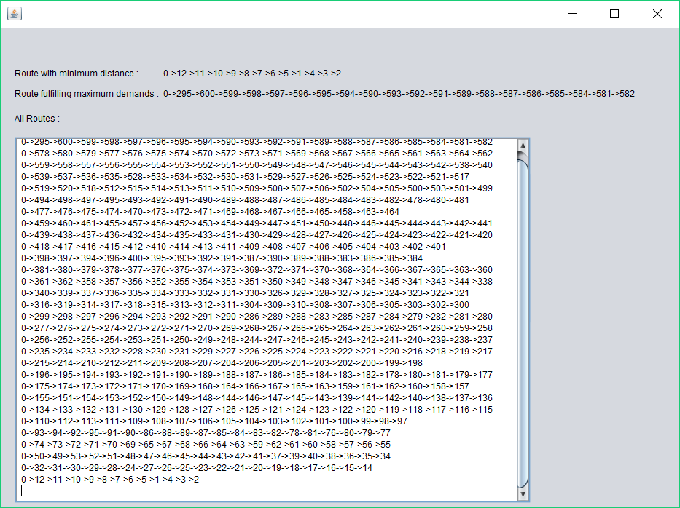
BEST AVAILABLE ROUTES

Slide 34
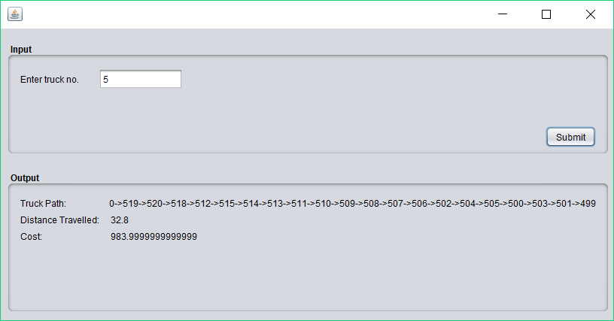
TRUCK ANALYSIS

Slide 35
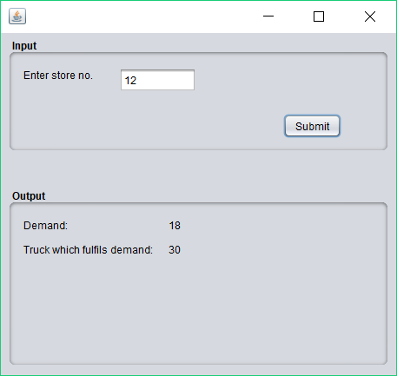
STORE ANALYSIS

Slide 36
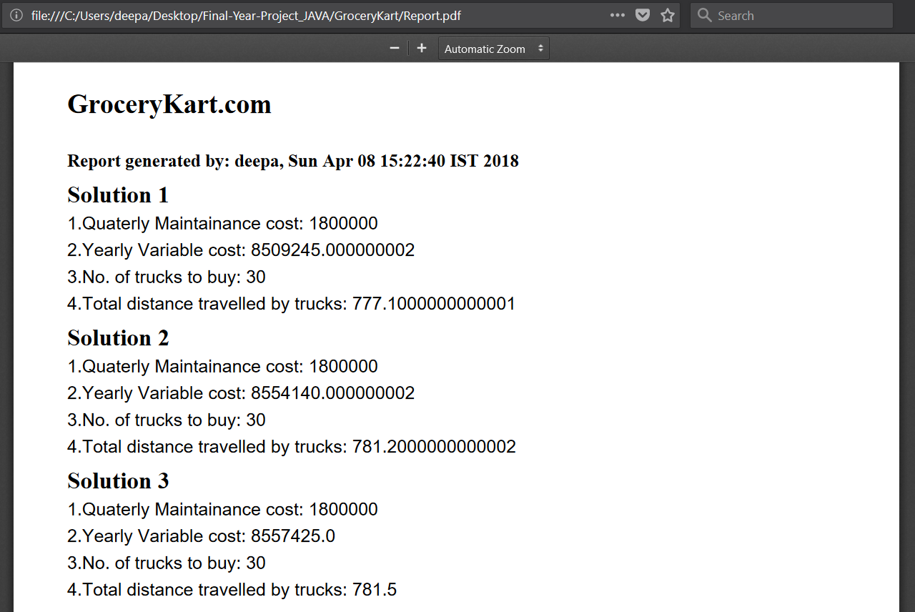
REPORT GENERATION

Slide 37
Result Comparison
PMX BCRC
Distance Time Taken Distance Time Taken
818.1 1 min 799.8 20 min
819.4 40 sec 807.8 12 min
821.599 30 sec 812.1 2 min

Slide 38
Future scope
The method used to solve this Transportation Service System for Grocery Kart problem can be referred to solve :
Location Allocation Problems.
Network Designing and routing problems.
Planning of Packet Switched networks.
A new algorithm can be invented and will run on updating the solutions only if any minimal changes occur in demand and distance matrix.

Slide 39
references
http://en.wikipedia.org/wiki/Genetic_algorithm
http://www.mu-sigma.com/muphoria/
K.C.Tan, L.H.Lee, Q.L.Zhu, K.OU,2000. Heuristic methods for vehicle routing problem with time windows, Artificial Intelligence in Engineering, 1-15

Slide 40
references
Mitsuo Gen and Runwei Cheng,2000. Genetic Algorithms and Engineering Optimization, Wiley Series, 340-400
Randy L.Haupt ,2004. Practical Genetic Algorithms -2nd Edition , Wiley Series, 200-250

Slide 41
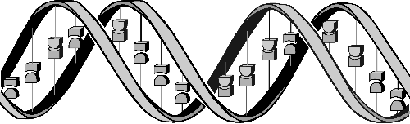
Question : ‘If GAs are so smart, why ain’t they rich?’
Answer : ‘Genetic algorithms are rich - rich in application across a large and growing number of disciplines.’

Slide 42
THANK YOU

